Slide 1

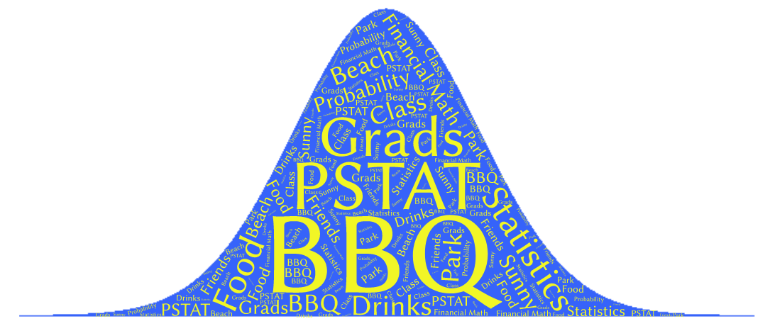
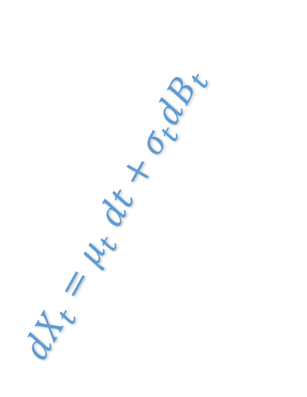
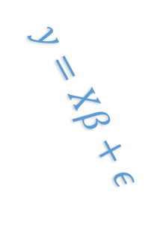

$$X∼N\left(μ,σ^{2}\right)$$
$$dX_{t}=μ_{t} dt+σ_{t}dB_{t}$$
$$y=Xβ+ε$$
Please join us!
PSTAT Graduate BBQ 2017
When: October 14th,2017 @ 12:00 PM
Where: Goleta Beach Park (5986 Sandspit Rd, Goleta, CA 93117)
Any questions at: zapata@pstat.ucsb.edu

